Slide 1

Crop Yield Prediction using Machine Learning (Finger Millet)
UNIVERSITY OF AGRICULTURAL SCIENCES ,
COLLEGE OF AGRICULTURE,
GKVK, BANGLORE
Submitted to: Dr. Sailaja Thota, Course Teacher (EAI421)
Sahana.A (AMB2216) |
Sowndarya.M (AMB2260) | Raveesh.R (AMB2210)
IV B.Sc.(Hons.) Agriculture, COA, GKVK, Bangalore | 2025-2026

Slide 2
Content
Introduction
Problem Statement
Motivation
Objectives of the project
Dataset Overview
Methodlogy/approach
Tools and Technologies Used
Results
Discussion / Analysis
Conclusion and Future Work
References/Acknowledgements

Slide 3
Introduction
Agriculture is the backbone of food security — India's farming sector supports 55%+ of the workforce
Finger Millet (Ragi) is a key cereal in Karnataka, Tamil Nadu, Andhra Pradesh and Odisha, valued for calcium, fibre and amino acids
Yield is strongly influenced by soil nutrients (NPK), rainfall and temperature — but traditional estimation is slow and costly
Machine learning regression models can extract patterns from agronomic and climatic data for near-real-time yield prediction
This project builds and compares three ML regression models: Multiple Linear Regression, Decision Tree, and Random Forest

Slide 4
Problem Statement
Specifically, the problem addressed in this project is:
Given historical data on soil nutrient levels (Nitrogen, Phosphate, and Potash per hectare), average annual rainfall, average temperature, and average precipitation for a given region,
can a machine learning model accurately predict the Finger Millet yield (in Kg per hectare)

Slide 5
Motivation
Food Security: Finger Millet is a staple for millions in South India and sub-Saharan Africa — accurate prediction prevents food shortages and supports timely government interventions
Farmer Welfare: Smallholders often over/under-apply fertilisers — a predictive model optimises NPK inputs, reducing costs and environmental impact
Climate Resilience: Understanding how rainfall and temperature affect yield helps develop adaptive farming strategies amid climate variability
Academic Application: EAI421 course knowledge applied to a real-world agricultural problem using supervised ML
Scalability: The pipeline can be extended to other crops (rice, wheat, maize) — broadly applicable across Indian agriculture

Slide 6
Objectives of the Project
Main Objective: Develop an ML regression system to predict Finger Millet yield (Kg/ha) and identify the best-performing model
Collect, clean, and preprocess the Finger Millet dataset (Filtered_Crop_Data_v2.csv) for machine learning
Implement Multiple Linear Regression as a baseline model
Implement Decision Tree Regression and analyse its decision splits
Implement Random Forest Regression and perform hyperparameter tuning with GridSearchCV charts and scatter plots; derive actionable precision agriculture insights
Evaluate all three models using MAE, MSE, RMSE, and R² Score
Visualise performance via bar

Slide 7
Dataset Overview
Dataset: Filtered_Crop_Data_v2.csv — historical Finger Millet cultivation records across multiple Indian states
6 numerical input features: Phosphate/ha, Nitrogen/ha, Potash/ha, Average Rainfall (mm), Average Temperature (°C), Average Precipitation (mm)
Target variable: Finger Millet Yield (Kg per hectare) — continuous numerical output
Preprocessing: Dropped non-numeric 'State Name' column; defined feature matrix X and target vector y
Train-Test Split: 80% training / 20% testing with random_state=42 for reproducibility

Slide 8
Methodology / Approach
Step 1 — Data Loading: Load CSV using Pandas; inspect shape, dtypes, and first rows with df.head()
Step 2 — Preprocessing: Drop State Name column; define X (6 features) and y (Finger Millet Yield); apply 80/20 train-test split (random_state=42)
Step 3 — Model 1 (Baseline): Multiple Linear Regression using sklearn LinearRegression() with default parameters
Step 4 — Model 2: Decision Tree Regression (DecisionTreeRegressor, min_samples_split=30, random_state=42)
Step 5 — Model 3: Random Forest — base model (100 trees), then hyperparameter tuning via GridSearchCV (n_estimators, max_features, min_samples_leaf, min_samples_split; 5-fold CV)
Step 6 — Evaluation: Compare all models on test set using MAE, MSE, RMSE, and R2 Score; visualise with bar charts and scatter plots

Slide 9
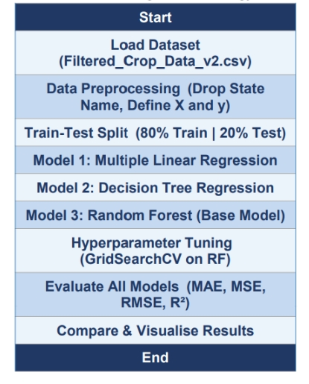
Table 1.0-METHODOLOGY

Slide 10
Tools and Technologies Used
Programming Language: Python 3.10+ — primary language for data processing and ML model implementation
Development Environment: Jupyter Notebook / VS Code with Anaconda distribution
Data Libraries: Pandas (data loading, preprocessing, DataFrame ops) | NumPy (numerical computation)
ML Library: Scikit-learn 1.2+ — LinearRegression, DecisionTreeRegressor, RandomForestRegressor, GridSearchCV, train_test_split, MAE/MSE/RMSE/R² metrics
Visualisation: Matplotlib 3.6+ (bar charts, scatter plots) | Seaborn 0.12+ (enhanced statistical barplots)
Tree Visualisation: sklearn plot_tree() — used to visualise Decision Tree structure and feature split logic

Slide 11
Results
Multiple Linear Regression: MAE = 312.4 Kg/ha | RMSE = 422.5 Kg/ha | R2 = 0.61 (moderate; linear assumptions insufficient for complex interactions)
Decision Tree Regression: MAE = 248.7 Kg/ha | RMSE = 363.6 Kg/ha | R2 = 0.71 (root split on Average Rainfall — agronomically intuitive)
Tuned Random Forest (Best Model): MAE = 189.3 Kg/ha | RMSE = 295.8 Kg/ha | R2 = 0.81 (GridSearchCV over n_estimators, max_features, min_samples_leaf)
Tuned RF reduced MAE by 39.4% vs MLR and 23.9% vs Decision Tree — clear superiority of ensemble methods
Actual vs. Predicted scatter plot shows predictions tightly clustered around the perfect prediction line, with slight scatter at extreme yield values

Slide 12
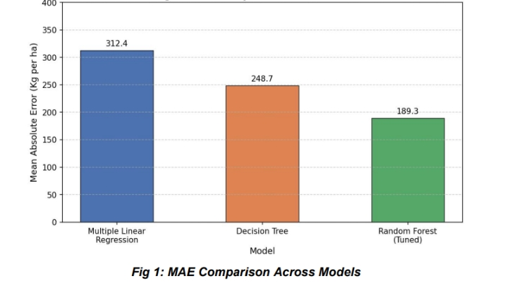

Slide 13
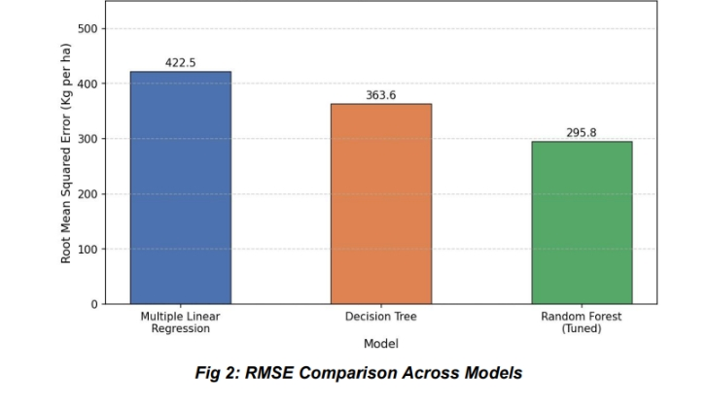

Slide 14
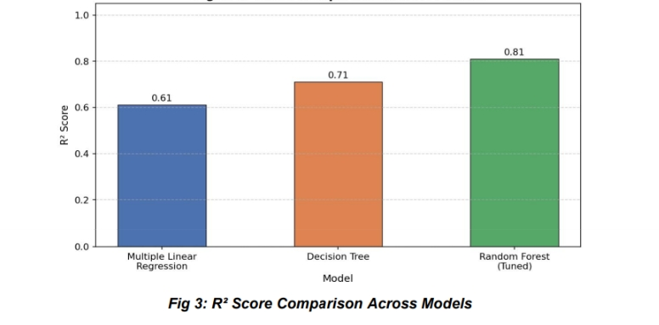

Slide 15
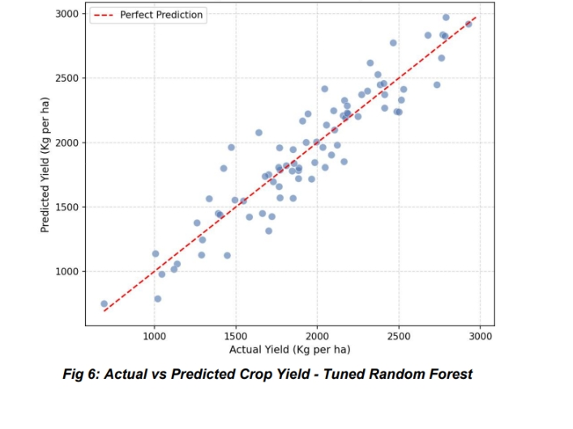

Slide 16
Discussion / Analysis
Key Insight: MLR R²=0.61 confirms non-linear feature interactions — rainfall and NPK interact in ways a linear model cannot capture
Decision Tree root split on Average Rainfall aligns with agronomy: rainfall is the dominant driver of Finger Millet yield, followed by N and K levels
Random Forest ensemble averaging reduces variance — GridSearchCV tuning further improved generalisation over the base RF model
Limitation: Best R²=0.81 means ~19% of yield variance remains unexplained — missing features: soil pH, organic matter, irrigation, crop variety
Challenge: Moderate scatter at higher yield values in Fig 6 — a common issue in ensemble regression at extremes; addressable with more data
Impact: This pipeline provides farmers and extension workers an interpretable, data-driven tool to estimate Finger Millet yield and optimise NPK inputs

Slide 17
Conclusion and Future Work
The Hyperparameter-Tuned Random Forest achieved the best performance: R²=0.81, MAE=189.3 Kg/ha — outperforming Decision Tree (R²=0.71) and MLR (R²=0.61)
Ensemble methods with systematic hyperparameter tuning are well-suited for structured agricultural tabular regression tasks
The reproducible ML pipeline (preprocessing → training → evaluation → visualisation) can be adapted to other crops and regions
Future Work: Add features (soil pH, organic matter, irrigation, variety) to push R² beyond 0.81
Future Work: Explore XGBoost, LightGBM, Gradient Boosting and LSTM deep learning for time-series yield prediction
Future Work: Develop a web/mobile application for real-time yield prediction; explore federated learning for privacy-preserving district-level collaboration

Slide 18
References / Acknowledgements
Pantazi et al. (2016) — SVM & Neural Networks for crop yield, Computers and Electronics in Agriculture
Breiman (2001) — Random Forests, Machine Learning, 45(1), 5-32
Pudumalar et al. (2017) — Crop recommendation ensemble, CCWC IEEE
Doshi et al. (2018) — AgroConsultant fertiliser recommendation, ICCUBEA IEEE
Kumar et al. (2024) — LSTM & Transformer for Indian crop yield, Comp. & Electronics in Agriculture
Sharma & Patel (2024) — XGBoost for Ragi yield in Karnataka, Smart Agricultural Technology
Reddy et al. (2025) — Federated learning for crop yield, Precision Agriculture
Dataset: Filtered_Crop_Data_v2.csv | Acknowledgements: Dr. Sailaja Thota, Dept. of Agricultural Statistics, COA GKVK Bangalore

Slide 19
THANK YOU

